Slide 1

HOTEL
AGGREGATOR
ANALYSIS
USING POWER BI
BY: KHUSHI KADD
PROFILE: DATA ANALYST INTERN
BATCH NAME: MIP-DA-07

Slide 2
PROBLEM STATEMENT
This internship project aims to analyse a dataset of hotel aggregator listings using Power BI. The dataset
comprises various attributes related to listings, hosts, reviews, and availability. The objective is to create
comprehensive visualizations and insights that shed light on trends, patterns, and factors influencing the
performance of listings. Through Power BI, interns will explore key metrics such as pricing, availability,
host characteristics, and review scores to derive actionable insights for improving the overall quality and competitiveness of the listings.

Slide 3
DATASET DESCRIPTION
1. id: Unique identifier for each listing.
2. listing_url: URL of the listing on the hotel aggregator platform.
3. scrape_id: Identifier for the data scraping event.
4. last_scraped: Date of the last data scrape.
5. source: Source of the listing information.
6. name: Name of the listing.
7. description: Description of the listing.
8. neighborhood_overview: Overview of the neighborhood where the listing is located.
9. picture_url: URL of the listing's picture.
10. host_id: Unique identifier for the host.
11. ... (and many more columns capturing details about hosts, location, property type, room details,
amenities, pricing, availability, reviews, and other relevant information)

Slide 4
PROJECT OBJECTIVES
1. Geographical Insights:
- Visualize the distribution of listings on a map to identify popular neighborhoods.
Explore the geographical concentration of listings and host locations.
2. Pricing and Availability Analysis:
- Analyze pricing trends based on property types, room types, and accommodation capacity.
- Investigate the availability of listings over time and identify peak periods.

Slide 5
3. Host Performance:
- Evaluate host characteristics, including superhost status, response times, and verification methods.
Explore correlations between host attributes and listing performance.
4. Review Scores and Guest Satisfaction:
- Examine review scores and their impact on overall listing performance.
- Identify areas for improvement based on specific review categories.

Slide 6
5. Property Type and Room Analysis:
- Analyse the distribution of property types and room types.
- Explore trends in the popularity of specific accommodation setups.

Slide 7
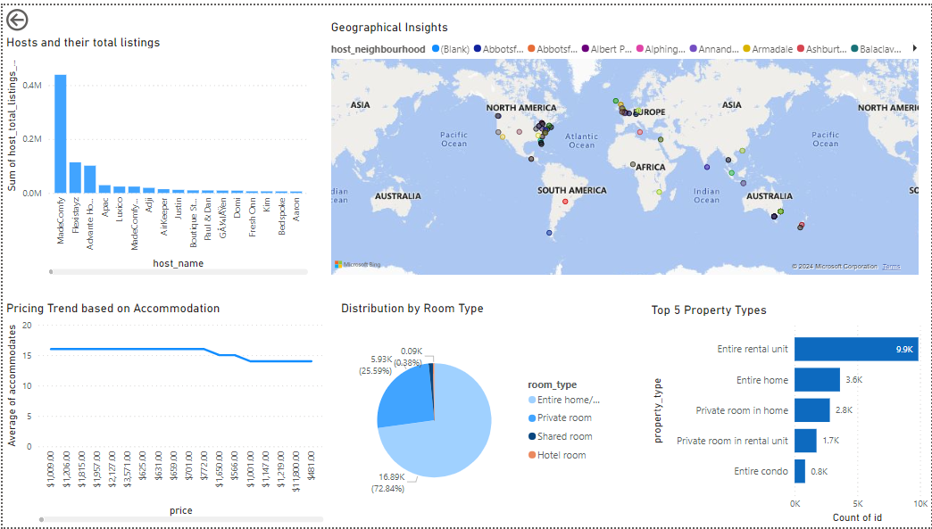

Slide 8
CONCLUSION
In conclusion, the Power BI Hotel Aggregator project has been instrumental
in leveraging data analytics to unlock insights from the intricate dataset
of hotel aggregator listings. Through meticulous analysis of listings, hosts, reviews, and availability attributes, the report has provided stakeholders
with a comprehensive understanding of key metrics and trends. The visualizations crafted using Power BI serve as powerful tools for
stakeholders to grasp complex data effectively, empowering them to make informed decisions to enhance listing quality and competitiveness.
This project exemplifies the transformative potential of Power BI in
driving data-driven strategies and optimizing business operations in the hospitality industry.

Slide 9
THANK YOU!!!

